Slide 1
Disney Quotes for Hot Topics

Slide 2
Decide what hot topics apply to this quote.
Success
Failure
Determination
Kindness
Friendship
Attitude
Dreams
Chances
Change
Promise
Help others
Actions
Struggle
Strength
Differences
Judgement
Learning
Goals
Obstacles
Challenges

Slide 3
Decide what hot topics apply to this quote.
Success
Failure
Determination
Kindness
Friendship
Attitude
Dreams
Chances
Change
Promise
Help others
Actions
Struggle
Strength
Differences
Judgement
Learning
Goals
Obstacles
Challenges

Slide 4
Decide what hot topics apply to this quote.
Success
Failure
Determination
Kindness
Friendship
Attitude
Dreams
Chances
Change
Promise
Help others
Actions
Struggle
Strength
Differences
Judgement
Learning
Goals
Obstacles
Challenges

Slide 5
Decide what hot topics apply to this quote.
Success
Failure
Determination
Kindness
Friendship
Attitude
Dreams
Chances
Change
Promise
Help others
Actions
Struggle
Strength
Differences
Judgement
Learning
Goals
Obstacles
Challenges

Slide 6
Decide what hot topics apply to this quote.
Success
Failure
Determination
Kindness
Friendship
Attitude
Dreams
Chances
Change
Promise
Help others
Actions
Struggle
Strength
Differences
Judgement
Learning
Goals
Obstacles
Challenges

Slide 7
Decide what hot topics apply to this quote.
Success
Failure
Determination
Kindness
Friendship
Attitude
Dreams
Chances
Change
Promise
Help others
Actions
Struggle
Strength
Differences
Judgement
Learning
Goals
Obstacles
Challenges

Slide 8
Decide what hot topics apply to this quote.
Success
Failure
Determination
Kindness
Friendship
Attitude
Dreams
Chances
Change
Promise
Help others
Actions
Struggle
Strength
Differences
Judgement
Learning
Goals
Obstacles
Challenges

Slide 9
Decide what hot topics apply to this quote.
Success
Failure
Determination
Kindness
Friendship
Attitude
Dreams
Chances
Change
Promise
Help others
Actions
Struggle
Strength
Differences
Judgement
Learning
Goals
Obstacles
Challenges

Slide 10
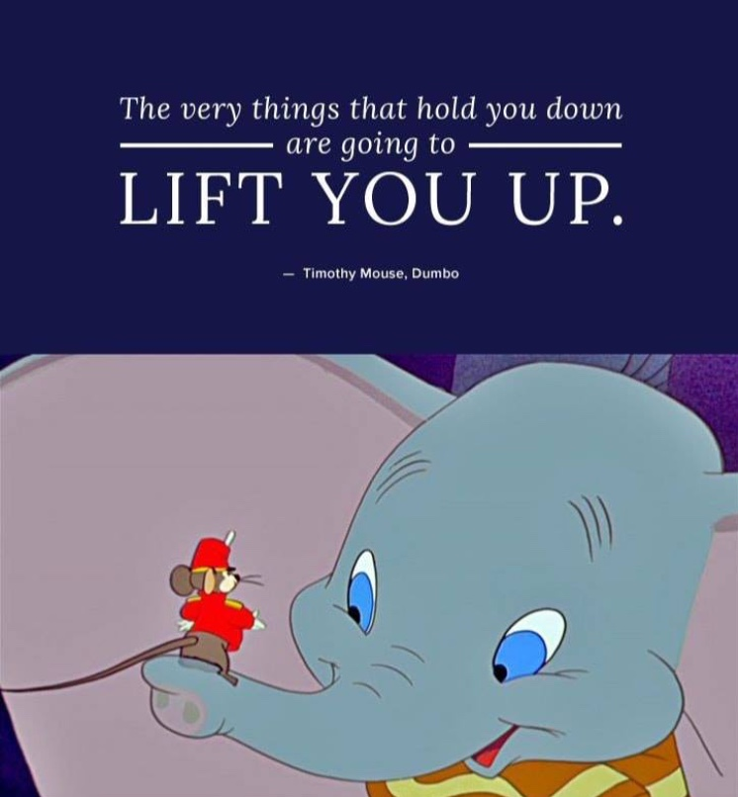
Decide what hot topics apply to this quote.
Success
Failure
Determination
Kindness
Friendship
Attitude
Dreams
Chances
Change
Promise
Help others
Actions
Struggle
Strength
Differences
Judgement
Learning
Goals
Obstacles
Challenges

Slide 11
Decide what hot topics apply to this quote.
Success
Failure
Determination
Struggle
Friendship
Attitude
Dreams
Chances
Change
Promise
Help others
Actions
Struggle
Strength
Differences
Judgement
Learning
Goals
Obstacles
Challenges

Slide 12
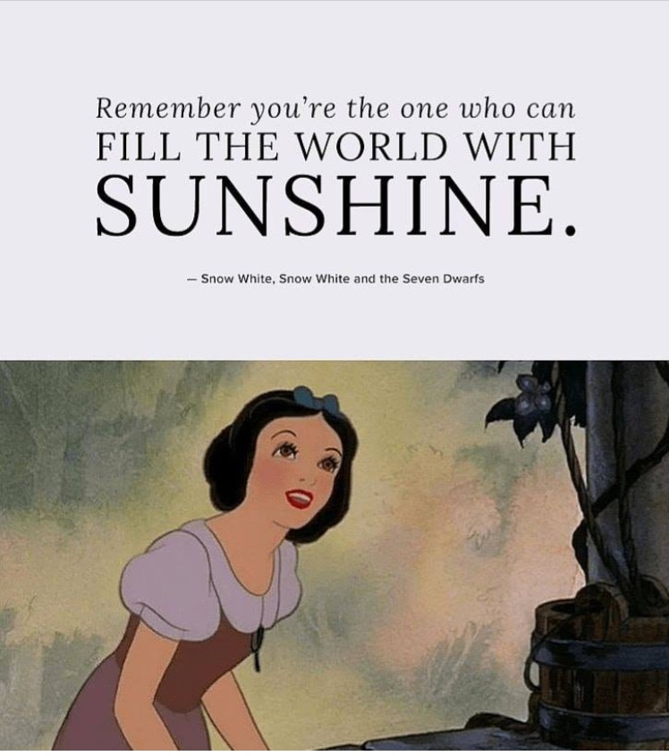
Decide what hot topics apply to this quote.
Success
Failure
Determination
Kindness
Friendship
Attitude
Dreams
Chances
Change
Promise
Help others
Actions
Struggle
Strength
Differences
Judgement
Learning
Goals
Obstacles
Challenges

Slide 13
Decide what hot topics apply to this quote.
Success
Failure
Determination
Struggle
Friendship
Attitude
Dreams
Chances
Change
Promise
Help others
Actions
Struggle
Strength
Differences
Judgement
Learning
Goals
Obstacles
Challenges

Slide 14
Decide what hot topics apply to this quote.
Success
Failure
Determination
Kindness
Friendship
Attitude
Dreams
Chances
Change
Promise
Help others
Actions
Struggle
Strength
Differences
Judgement
Learning
Goals
Obstacles
Challenges

Slide 15
Decide what hot topics apply to this quote.
Success
Failure
Determination
Struggle
Friendship
Attitude
Dreams
Chances
Change
Promise
Help others
Actions
Struggle
Strength
Differences
Judgement
Learning
Goals
Obstacles
Challenges

Slide 16
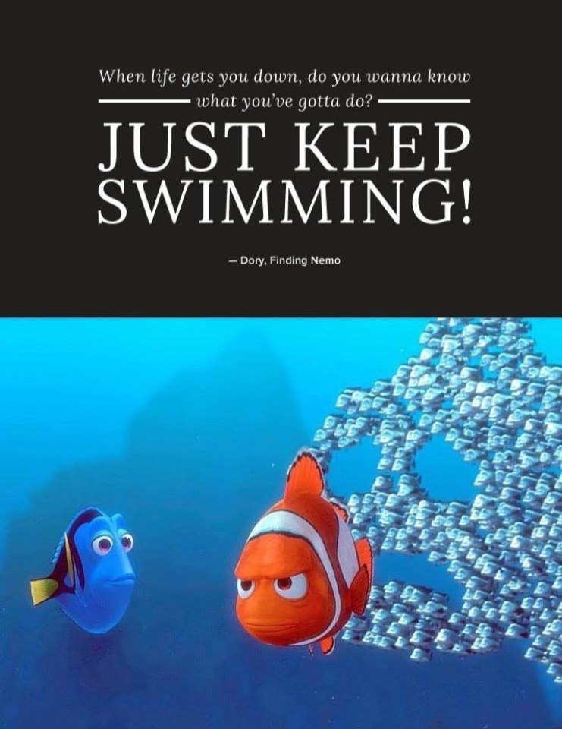
Decide what hot topics apply to this quote.
Success
Failure
Determination
Kindness
Friendship
Attitude
Dreams
Chances
Change
Promise
Help others
Actions
Struggle
Strength
Differences
Judgement
Learning
Goals
Obstacles
Challenges

Slide 17
Decide what hot topics apply to this quote.
Success
Failure
Determination
Kindness
Friendship
Attitude
Dreams
Chances
Change
Promise
Help others
Actions
Struggle
Strength
Differences
Judgement
Learning
Goals
Obstacles
Challenges

Slide 18
Decide what hot topics apply to this quote.
Success
Failure
Determination
Kindness
Friendship
Attitude
Dreams
Chances
Change
Promise
Help others
Actions
Struggle
Strength
Differences
Judgement
Learning
Goals
Obstacles
Challenges

Slide 19
Decide what hot topics apply to this quote.
Success
Failure
Determination
Struggle
Friendship
Attitude
Dreams
Chances
Change
Promise
Help others
Actions
Struggle
Strength
Differences
Judgement
Learning
Goals
Obstacles
Challenges

Slide 20
Decide what hot topics apply to this quote.
Success
Failure
Determination
Kindness
Friendship
Attitude
Dreams
Chances
Change
Promise
Help others
Actions
Struggle
Strength
Differences
Judgement
Learning
Goals
Obstacles
Challenges

Slide 21
Decide what hot topics apply to this quote.
Success
Failure
Determination
Struggle
Friendship
Attitude
Dreams
Chances
Change
Promise
Help others
Actions
Struggle
Strength
Differences
Judgement
Learning
Goals
Obstacles
Challenges

Slide 22
Decide what hot topics apply to this quote.
Success
Failure
Determination
Kindness
Friendship
Attitude
Dreams
Chances
Change
Promise
Help others
Actions
Struggle
Strength
Differences
Judgement
Learning
Goals
Obstacles
Challenges

Slide 23
Decide what hot topics apply to this quote.
Success
Failure
Determination
Kindness
Friendship
Attitude
Dreams
Chances
Change
Promise
Help others
Actions
Struggle
Strength
Differences
Judgement
Learning
Goals
Obstacles
Challenges

Slide 24
Decide what hot topics apply to this quote.
Success
Failure
Determination
Kindness
Friendship
Attitude
Dreams
Chances
Change
Promise
Help others
Actions
Struggle
Strength
Differences
Judgement
Learning
Goals
Obstacles
Challenges

Slide 25
Decide what hot topics apply to this quote.
Success
Failure
Determination
Kindness
Friendship
Attitude
Dreams
Chances
Change
Promise
Help others
Actions
Struggle
Strength
Differences
Judgement
Learning
Goals
Obstacles
Challenges

Slide 26
Decide what hot topics apply to this quote.
Success
Failure
Determination
Kindness
Friendship
Attitude
Dreams
Chances
Change
Promise
Help others
Actions
Struggle
Strength
Differences
Judgement
Learning
Goals
Obstacles
Challenges

Slide 27
Decide what hot topics apply to this quote.
Success
Failure
Determination
Struggle
Friendship
Attitude
Dreams
Chances
Change
Promise
Help others
Actions
Struggle
Strength
Differences
Judgement
Learning
Goals
Obstacles
Challenges

Slide 28
Decide what hot topics apply to this quote.
Success
Failure
Determination
Kindness
Friendship
Attitude
Dreams
Chances
Change
Promise
Help others
Actions
Struggle
Strength
Differences
Judgement
Learning
Goals
Obstacles
Challenges

Slide 29
Decide what hot topics apply to this quote.
Success
Failure
Determination
Kindness
Friendship
Attitude
Dreams
Chances
Change
Promise
Help others
Actions
Struggle
Strength
Differences
Judgement
Learning
Goals
Obstacles
Challenges

Slide 30
Decide what hot topics apply to this quote.
Success
Failure
Determination
Kindness
Friendship
Attitude
Dreams
Chances
Change
Promise
Help others
Actions
Struggle
Strength
Differences
Judgement
Learning
Goals
Obstacles
Challenges

Slide 31
Decide what hot topics apply to this quote.
Success
Failure
Determination
Kindness
Friendship
Attitude
Dreams
Chances
Change
Promise
Help others
Actions
Struggle
Strength
Differences
Judgement
Learning
Goals
Obstacles
Challenges

